Slide 1
Species vs Organisms

Slide 2
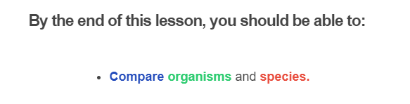
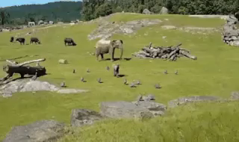

Slide 3
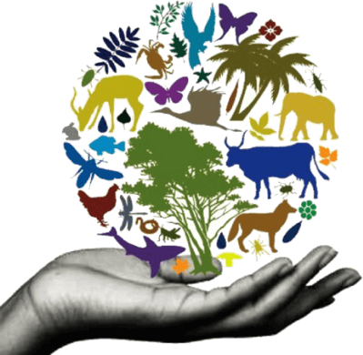
An organism is any living thing.
Plants, animals and bacteria are all organisms!

Slide 4
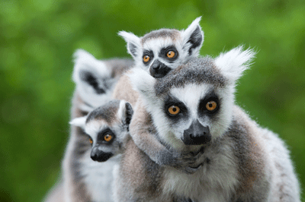
A species is a group of organisms with similar features.
Members of the same species can breed to produce fertile offspring.

Slide 5

For example...
A male lion and a female lion are the same species, so they can reproduce and have healthy cubs.
A male snake and a female crab cannot reproduce and have babies, because they are different species!

Slide 6
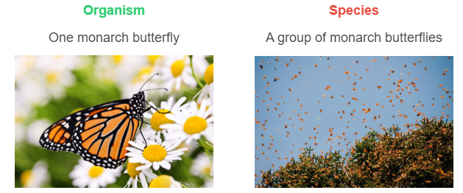
Let's use one more example to highlight the difference between organisms and species.

